Slide 1


Biosensor Data Fusion for Monitoring of Global Neurophysiological Function
Mohammad Montazeri
PhD Candidate of Engineering
University of Nebraska-Lincoln
mmontazeri@huskers.unl.edu

Slide 2
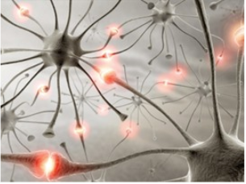
EPILEPSY
One of the most common genetic neurological disorders.
Abnormal neuron activity in brain that triggers seizures.
Unexpected behavior, symptoms, and sensations, sometimes includes loss of consciousness.

Slide 3
Objective of the Research
Goal: Detecting the electrophysiological component called the late positive potential (LPP)
Arousing images typically are associated with higher amplitudes
Neutral images are associated with lower amplitudes
Found at about 500 to 900 ms after image onset

Slide 4
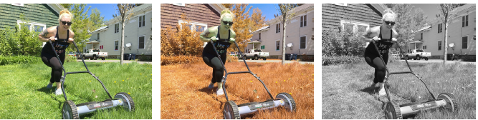
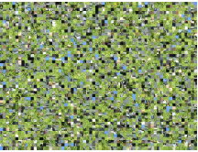
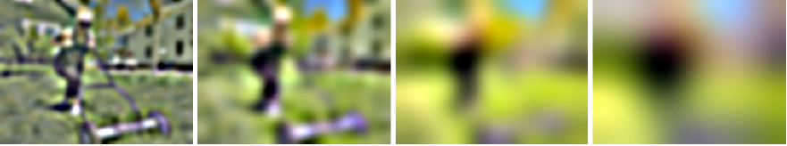
Experiment
Participants briefly (~33 ms) viewed bodily mutilation and neutral natural scenes that were immediately backward masked.
True color
False color
Achromatic
Mask
Images bandpassed at four spatial frequency (SF) ranges:
16-32 cpi
8-16 cpi
4-8 cpi
2-4 cpi
Notes:
False color: red-green inverted.
After each image, subjects categorized the image as either unpleasant or neutral.

Slide 5
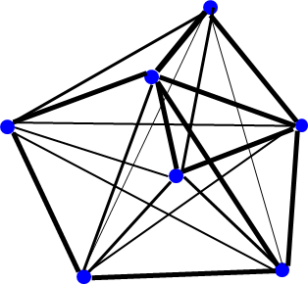

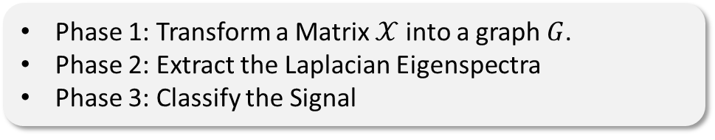

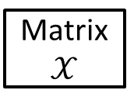
Overview of the approach
Phase 1: Transform a Matrix $𝒳$into a graph $G$.
Phase 2: Extract the Laplacian Eigenspectra
Phase 3: Classify the Signal
Phase 1
Graph representation
Phase 2
Laplacian Eigenspectra
Phase 3
Classification
Similarity matrix ($S$)
Weighted, Undirected Graph
G(V,E,W)
Matrix $𝒳$
Laplacian matrix ($ℒ$)
Classify the signal
Eigenspectra (λ, $v$)
Graph Fourier Coefficients ($ℂ$)

Slide 6
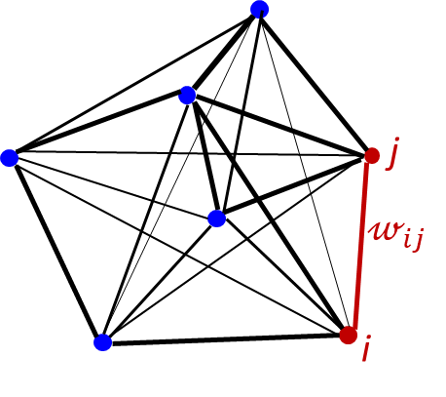






How to Build the Graph
Each sensor is one node
$$𝓌_{ij}=\left(\vec{x_{i}}−\vec{x_{j}}\right)V^{−1}{\left(\vec{x_{i}}−\vec{x_{j}}\right)}^{T}$$
$$\left[\begin{matrix}\begin{matrix} \\ \end{matrix} & ⋯ & \begin{matrix} \\ \end{matrix} \\ ⋮ & ⋱ & ⋮ \\ & ⋯ & \end{matrix}\right]$$
Similarity matrix
$$S^{N×N} ≝\left[𝓌_{ij}\right]$$
129 Rows
$𝒳$=
Each brain state at time t is one node
$$\left[\begin{matrix}\begin{matrix} \\ \end{matrix} & ⋯ & \begin{matrix} \\ \end{matrix} \\ ⋮ & ⋱ & ⋮ \\ & ⋯ & \end{matrix}\right]$$
$𝒳$=
1501 Columns

Slide 7
Preliminary Analysis
True Color Dataset | Spatial Frequency | Sensors | Input Values (Predictors) | GFC Basis Type | Algorithm | Results (F-score)
One Subject | Highest | Selected (21) | Laplacian GFCs | Ind. Neu. | Linear SVM | 72%
Confusion Matrix
True Classes ↓ | Predicted Classes
 | Neutral | Mutilation
Neutral | 19 (out of 23) | 4 (False Alarm)
Mutilation | 9 (Failing to detect) | 15 (out of 24)

